Slide 1
Cloud Service Models
Understanding IaaS, PaaS, and SaaS

Slide 2
Introduction to Cloud Service Models
Definition:
Service models define how cloud services are delivered to users, based on the level of control and management responsibility.
Key Service Models:
Infrastructure as a Service (IaaS)
Platform as a Service (PaaS)
Software as a Service (SaaS)

Slide 3
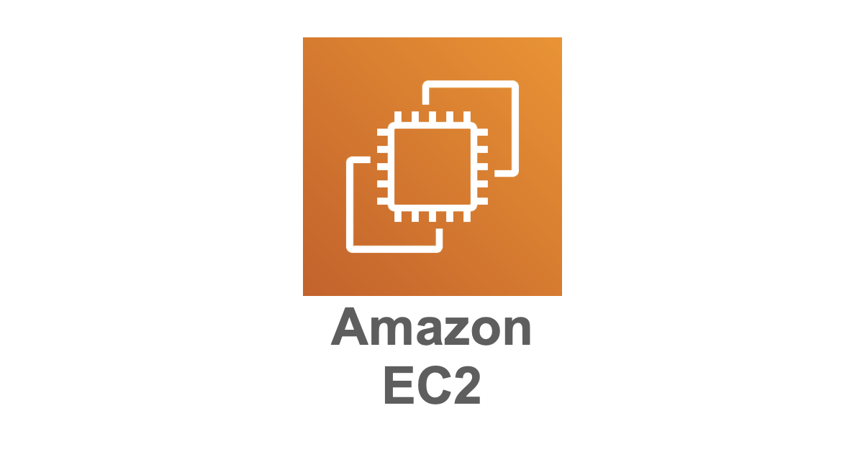
1. Infrastructure as a Service (IaaS)
Provides virtualized computing resources over the internet.
Users manage operating systems, applications, and data while the cloud provider manages hardware and virtualization.
Examples:
Amazon Web Services (AWS) EC2
Google Compute Engine
Microsoft Azure Virtual Machines
Key Features:
Virtual machines, storage, and networks.
High flexibility and scalability.

Slide 4
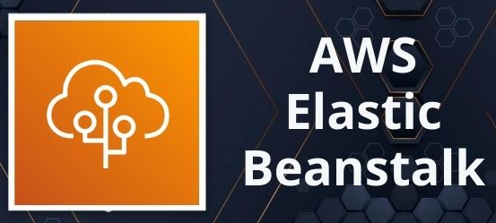
2. Platform as a Service (PaaS)
Provides a platform that allows developers to build, test, deploy, and manage applications without worrying about the underlying infrastructure.
The cloud provider manages OS, runtime, and middleware.
Examples:
Google App Engine
Microsoft Azure App Service
AWS Elastic Beanstalk
Heroku
Key Features:
Simplifies development and deployment.
Ideal for application development without infrastructure management.

Slide 5

3. Software as a Service (SaaS)
Delivers software applications over the internet on a subscription basis.
Users access applications via a web browser while the cloud provider manages everything.
Examples:
Gmail
Microsoft Office 365
Salesforce
Key Features:
No installation required.
Accessible from anywhere with an internet connection.

Slide 6
Key Differences Between Service Models
Aspect | IaaS | PaaS | SaaS
User Responsibility | Apps, data, OS | Apps, data | Only usage
Provider Responsibility | Hardware, virtualization | Hardware, OS, runtime | Everything
Use Case | Full Controll and flexibility | Development platforms | End-user applications

Slide 7
Advantages and Disadvantages
IaaS:
Advantages: High control and scalability.
Disadvantages: Complex management required.
PaaS:
Advantages: Simplifies app development.
Disadvantages: Limited control over the environment.
SaaS:
Advantages: Easy to use and maintain.
Disadvantages: Limited customization.

Slide 8

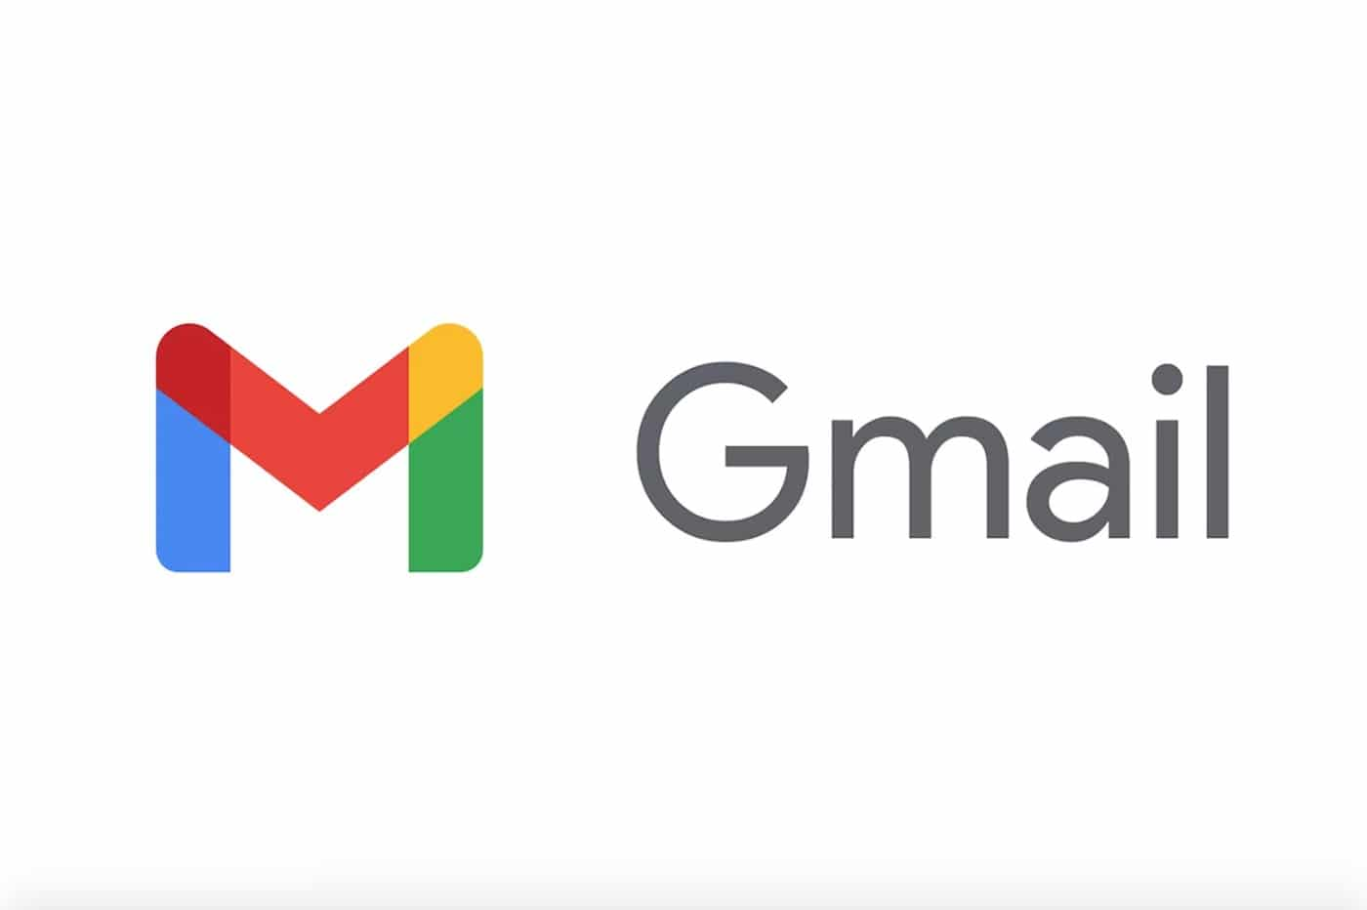
Case Study – Comparing Real-World Examples
IaaS Example:
Use AWS EC2 to host a website where you manage the server, storage, and OS.
PaaS Example:
Use Heroku to develop and deploy a web application.
SaaS Example:
Use Gmail for email management.

Slide 9
Identify the Service Model
Example 1: Hosting a virtual machine on Azure.
Example 2: Building a web app on AWS Elastic Beanstalk.
Example 3: Using Dropbox to store files.

Slide 10
Identify the Service Model
Example 1: Hosting a virtual machine on Azure. (Answer: IaaS)
Example 2: Building a web app on AWS Elastic Beanstalk. (Answer: PaaS)
Example 3: Using Dropbox to store files. (Answer: SaaS)

Slide 11
Summary
Cloud service models offer varying levels of control and abstraction.
IaaS: High control over infrastructure.
PaaS: Simplifies app development.
SaaS: End-user applications delivered over the internet.

